Slide 1
1.6.13 Polynomials with real coefficients

Slide 2
Outline
In this topic, we will
Examine the properties of the roots of polynomials with real coefficients
Look at some examples
Emphasize that this is one of the most important results in this course

Slide 3
Polynomials with real coefficients
A polynomial with real coefficients is any polynomial where all coefficients are real.
For example ,
z⁵ + 4.2z⁴ + 2.7z³ + 9.3z² – 0.8z + 1.2
Any such polynomial of degree n may be written as
Important: the coefficient of z^{k} is α_{k}

Slide 4
Properties of the complex conjugate
Let us review the properties of the complex conjugate:
For any complex z:
For a real number α,
For the sum of two complex numbers,
Consequently,
For the product of two complex numbers,
For a complex number raised to an integer exponent,

Slide 5
Polynomials with real coefficients
Suppose that r is a root of a complex polynomial with real coefficients:
We have two possibilities: either r is real, or r is not real
Let us suppose that r is not real

Slide 6
Polynomials with real coefficients
If r is not real, let us conjugate both sides of
Is this not ?
Consequently, if r is a root, the r* is also a root
But each

Slide 7
Polynomials with real coefficients
Theorem:
If p is a polynomial with real coefficients, and r is a root, then so is r*.
Proof: Assume .
But each
▮

Slide 8
Polynomials with real coefficients
To reiterate:
If p is a polynomial with real coefficients and r is a non-real complex root of p then r* is also a root of p
We will describe r and r* as a complex-conjugate pair
More generally, if p is a polynomial with real coefficients and r is a non-real complex root with multiplicity m, then r* is also a root of p, also of multiplicity m
Is this not ?
Consequently, if r is a root, the r* is also a root

Slide 9
Polynomials with non-real coefficients
Note that if the coefficients are not real,
then the correct statement is
If r is a root of the polynomial p,
then r* is a root of the polynomial with the conjugate of the coefficients
For example, r = 2 – j is a root of z² + (1 – 4j)z – 1 + 13j
Therefore, r* = 2 + j is a root of z² + (1 + 4j)z – 1 – 13j
Evaluating the first polynomial at r* = 2 + j results in 8 + 10j ≠ 0

Slide 10
Examples
To demonstrate,
We already know the roots of z² + 1 are j and –j
The roots of z² + bz + c are
If b² – 4c ≥ 0, then both roots are real
If b² – 4c < 0, then the roots are

Slide 11
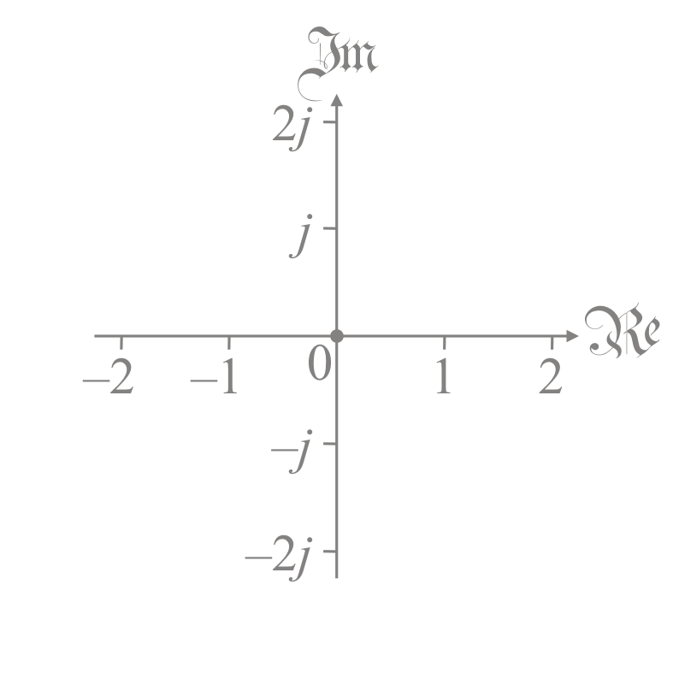
Examples
To demonstrate,
Consider the polynomial
Its roots are:
–0.035181403011327564 + 0.51437834108030281j
–0.035181403011327564 – 0.51437834108030281j
–1.0777404719073206 + 1.9229758521534597j
–1.0777404719073206 – 1.9229758521534597j
– 0.77415625016270363

Slide 12
Examples
To demonstrate,
Consider the polynomial
Its roots are:
–0.28217940701111523
–1
–2.5426012611094618
–0.087609665939711494 + 1.6673028066114304j
–0.087609665939711494 – 1.6673028066114304j

Slide 13
Summary
In this topic, you now
Understand the significance of the roots of a polynomial with real coefficients
Their roots are either real or come in complex conjugate pairs
Have been exposed to the proof
Are aware of some examples of this result
Should be aware that this will be one of the most significant results in this course

Slide 14
References
[1] https://en.wikipedia.org/wiki/Complex_conjugate_root_theorem

Slide 15
Acknowledgments
None so far.

Slide 16
Colophon
These slides were prepared using the Cambria typeface. Mathematical equations use Times New Roman, and source code is presented using Consolas. Mathematical equations are prepared in MathType by Design Science, Inc.
Examples may be formulated and checked using Maple by Maplesoft, Inc.
The photographs of flowers and a monarch butter appearing on the title slide and accenting the top of each other slide were taken at the Royal Botanical Gardens in October of 2017 by Douglas Wilhelm Harder. Please see
https://www.rbg.ca/
for more information.

Slide 17
Disclaimer
These slides are provided for the ne 112 Linear algebra for nanotechnology engineering course taught at the University of Waterloo. The material in it reflects the authors’ best judgment in light of the information available to them at the time of preparation. Any reliance on these course slides by any party for any other purpose are the responsibility of such parties. The authors accept no responsibility for damages, if any, suffered by any party as a result of decisions made or actions based on these course slides for any other purpose than that for which it was intended.

